Slide 1
BRITISH AIRWAYS
Web Scraping to Gain Company Insights

Slide 2
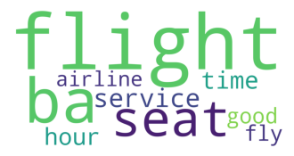
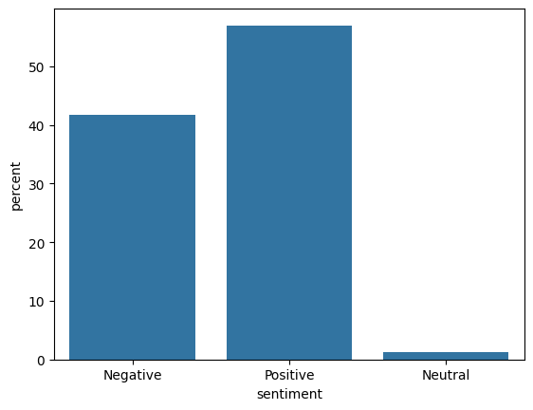
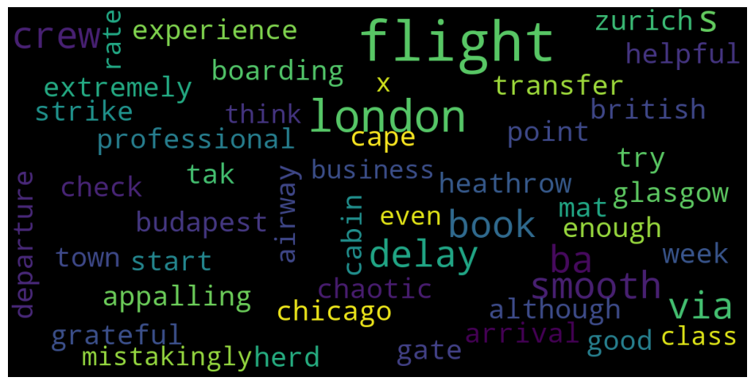
Insights
Out of 1000 reviews:
~ 74% are verified
~ 57% are positive
~ 42% are negative
~ 01% are neutral
10 Most Frequent Words:

